Slide 1
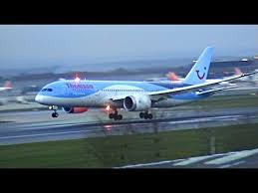

FLIGHTS IN 2014
Data analysis between different carriers
IN 2014

Slide 2

INTRODUCTION
                The data comprises of different carriers and their services to travelers across all the cities of the U.S.
                The data was used as it gave detailed information about how companies give services to their customers concerning time.
                The presentation will include graphs, charts, and tables to show which is the best performing company

Slide 3
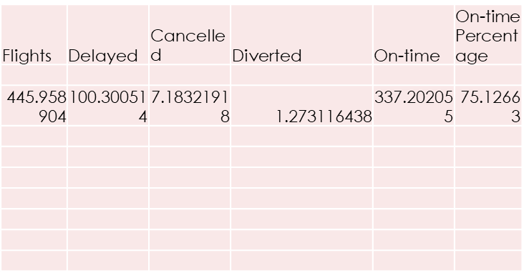
The average incidences
The mean values of incidences of flights on time, delayed, diverted, cancelled across all the company.
An average of 446 flights were made and approximately 337 on average were on time and as planned. The rest had issues
                Approximately 75.6% of flights scheduled are on time.

Slide 4
DELAYS
The graph showing how different carriers delayed flights.
                Southwest carrier proved to by the leading in delaying flight to travelers

Slide 5
SUM FLIGHTS
  This graph represents the total number of flights that was covers by different carriers in the United States cities.
  - Southwest is the most busy carrier in the country and virgin is not regarded by many.

Slide 6
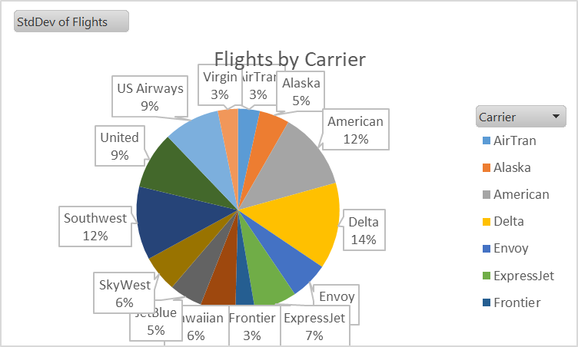
Carrier selectiveness
The pie chart below analysis the standard deviation of the flights by the different carriers.
                Standard deviation shows how much the data is distributed.
                In the outlined carriers the standard deviations are so close to each other hence the data is not wide spread.
                The travelers travelling with different carriers are not much selective of the carrier.

Slide 7
Correlation analysis
The following table shows correlation between different carriers in their service delivery
The correlation statistics shows how the data
values are related. For instance, from the
table, there is a strong correlation between
delay and the number of travelers.
Correlation analysis is the best statistical tool
for this type of data.
 | Flights | Delayed | Cancelled | Diverted | On-time
Flights | 1
Delayed | 0.941048 | 1
Cancelled | 0.626761 | 0.710905 | 1
Diverted | 0.770058 | 0.754742 | 0.52473 | 1
On-time | 0.995093 | 0.903507 | 0.576742 | 0.755293 | 1

Slide 8
Descriptive analysis
Flights |  | Delayed |  | Cancelled |  | Diverted |  | On-time
Mean | 445.1834 | Mean | 100.0874 | Mean | 7.166238 | Mean | 1.261354 | Mean | 336.6684
Standard Error | 33.82138 | Standard Error | 6.974413 | Standard Error | 0.675555 | Standard Error | 0.139129 | Standard Error | 26.85939
Median | 146 | Median | 30 | Median | 1 | Median | 0 | Median | 108
Mode | 31 | Mode | 5 | Mode | 0 | Mode | 0 | Mode | 25
Standard Deviation | 1155.385 | Standard Deviation | 238.2556 | Standard Deviation | 23.07791 | Standard Deviation | 4.752835 | Standard Deviation | 917.554
Sample Variance | 1334914 | Sample Variance | 56765.72 | Sample Variance | 532.5898 | Sample Variance | 22.58944 | Sample Variance | 841905.4
Kurtosis | 93.79966 | Kurtosis | 42.52566 | Kurtosis | 72.63303 | Kurtosis | 93.43498 | Kurtosis | 126.145
Skewness | 7.801709 | Skewness | 5.57024 | Skewness | 7.553629 | Skewness | 8.513065 | Skewness | 8.946805
Range | 19955 | Range | 3180 | Range | 311 | Range | 77 | Range | 17541
Minimum | 1 | Minimum | 0 | Minimum | 0 | Minimum | 0 | Minimum | 0
Maximum | 19956 | Maximum | 3180 | Maximum | 311 | Maximum | 77 | Maximum | 17541
Sum | 519529 | Sum | 116802 | Sum | 8363 | Sum | 1472 | Sum | 392892
Count | 1167 | Count | 1167 | Count | 1167 | Count | 1167 | Count | 1167
Largest(1) | 19956 | Largest(1) | 3180 | Largest(1) | 311 | Largest(1) | 77 | Largest(1) | 17541
Smallest(1) | 1 | Smallest(1) | 0 | Smallest(1) | 0 | Smallest(1) | 0 | Smallest(1) | 0
Confidence Level(95.0%) | 66.35756 | Confidence Level(95.0%) | 13.6838 | Confidence Level(95.0%) | 1.32544 | Confidence Level(95.0%) | 0.272971 | Confidence Level(95.0%) | 52.69815
The following table
is the descriptive
part of the data

Slide 9

conclusion
              The way a company serves its customers determines have significant effects in the competition (Reynolds-Feighan, 2018).
              From the statistics, a company with most of the flights on time is regarded by most of the people.
              Statistics in any industries helps the company to better their management skills to care for their consumer welfare (Wensveen, 2018).

Slide 10
references
Wensveen, J. (2018). Air transportation: A management perspective. Routledge.
Reynolds-Feighan, A. (2018). US feeder airlines: Industry structure, networks and performance. Transportation Research Part A: Policy and Practice, 117, 142-157.

